Slide 1

Atomic Modules
Saber Hamidi Phinephas Aasre Yanzhong Su Ahmet Novalic Rihards Baranovskis

Slide 2
What is Atomic Modules?
A mobile app
rate their modules
collaborate on notes
Leave insightful feedback

Slide 3
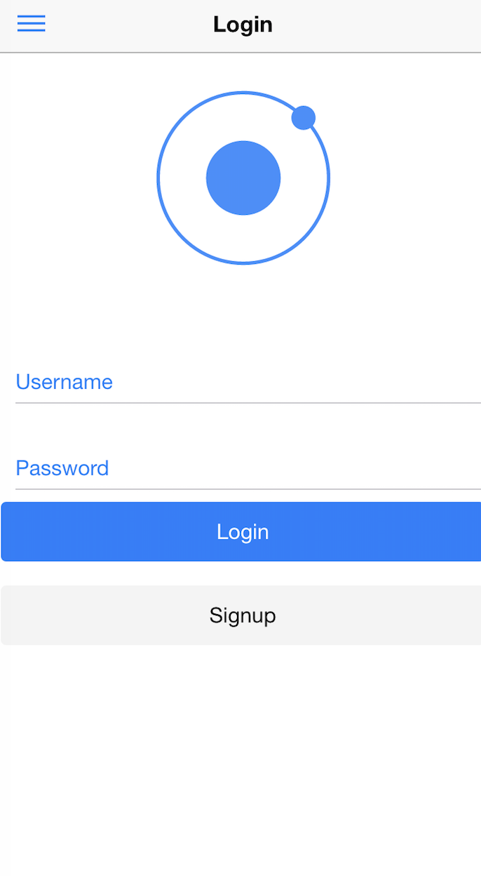
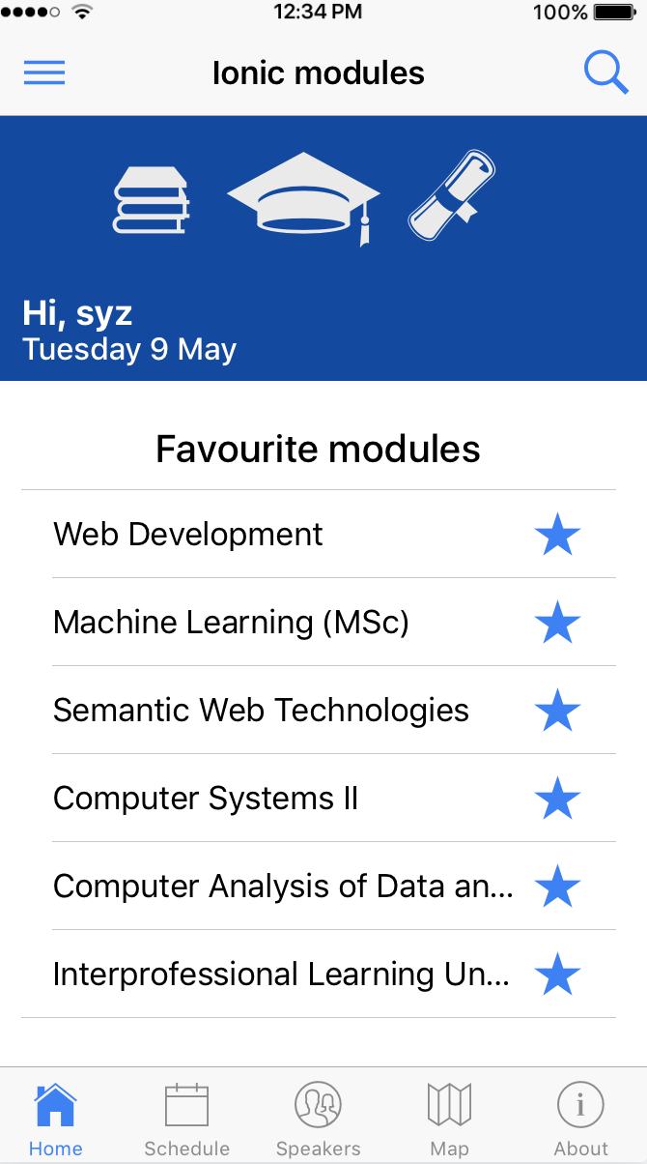

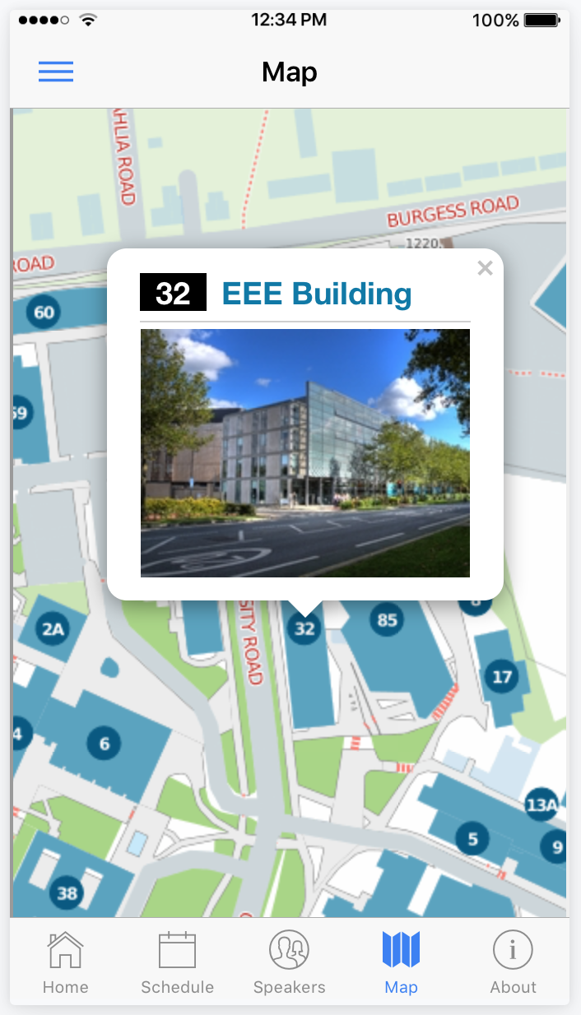
Atomic Modules App

Slide 4
Technologies used
Node.js + Express + MongoDB + Angular.js
Ionic framework
Cross platform functionality
Heroku PAAS
Collaboration tools
Google Drive
Slack
GitHub
Data sources:
Soton Open Data
Udacity/Coursera/Udemy
Maps

Slide 5
Extending The App Functionality
Classifying students based on the Modules they are performing well.
This info can be shared with external companies to help them find graduates with relevant skills.
Offer access to universities, recruiters or other stakeholders

Slide 6
Business model
Connect students with recruiters
Find top students in certain subjects
Find students with certain interest
Make the recruitment process easy

Slide 7
Financials
Costs
3 full time developers (£150k per year)
£ 20k per year
Marketing: £60k per year
Total: £230k per year
Profits
2.28 million students in UK
20% of potential users, 5% potential conversion rate
Average royalty of £25 per course (5%) recommended
Total revenue: £570k (£340k profit)

Slide 8
Thanks! Questions?

